Slide 1
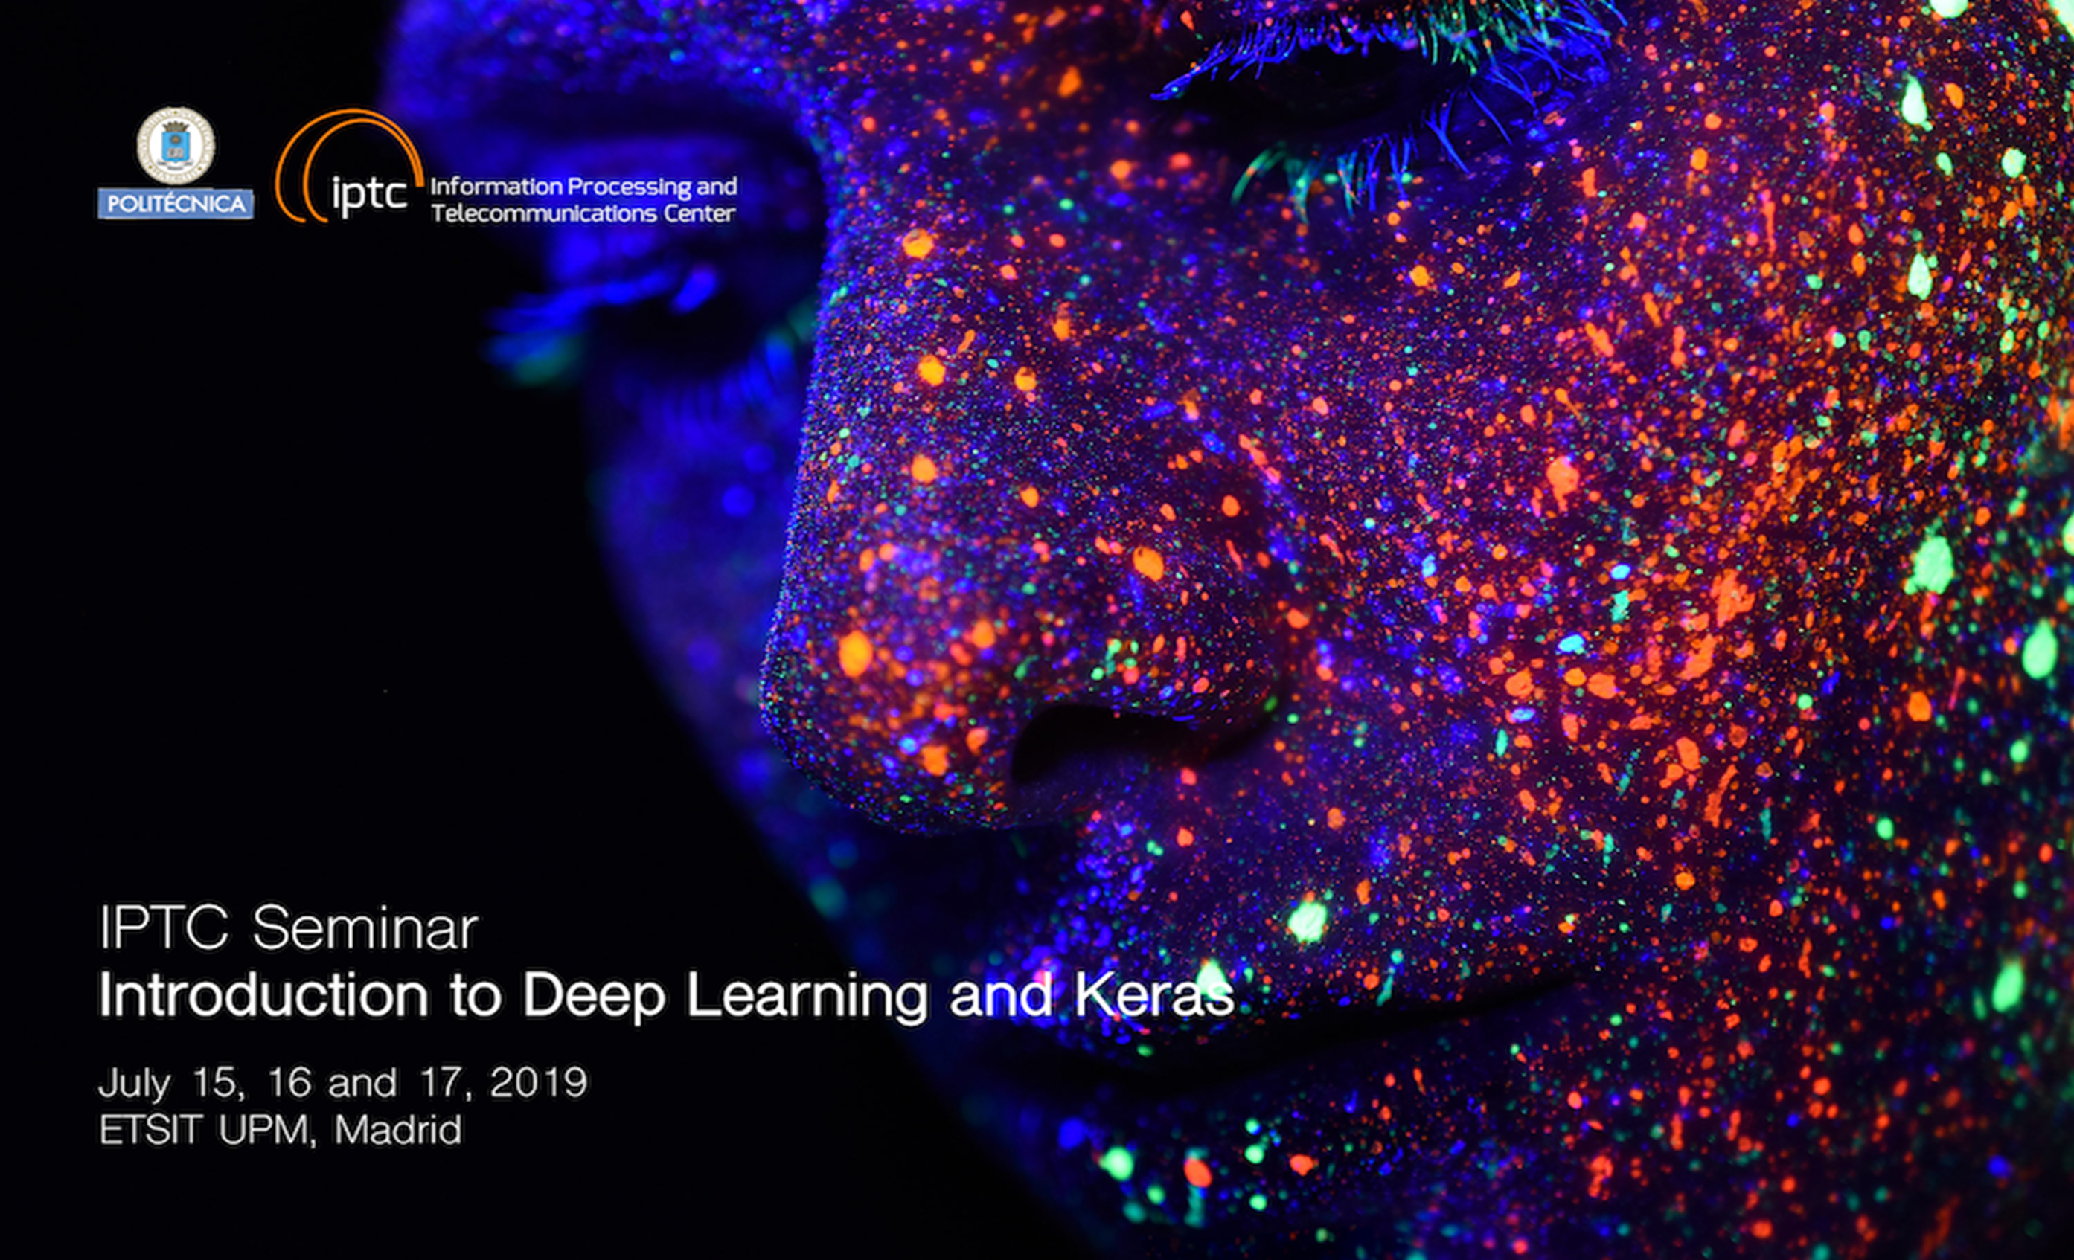

Slide 2
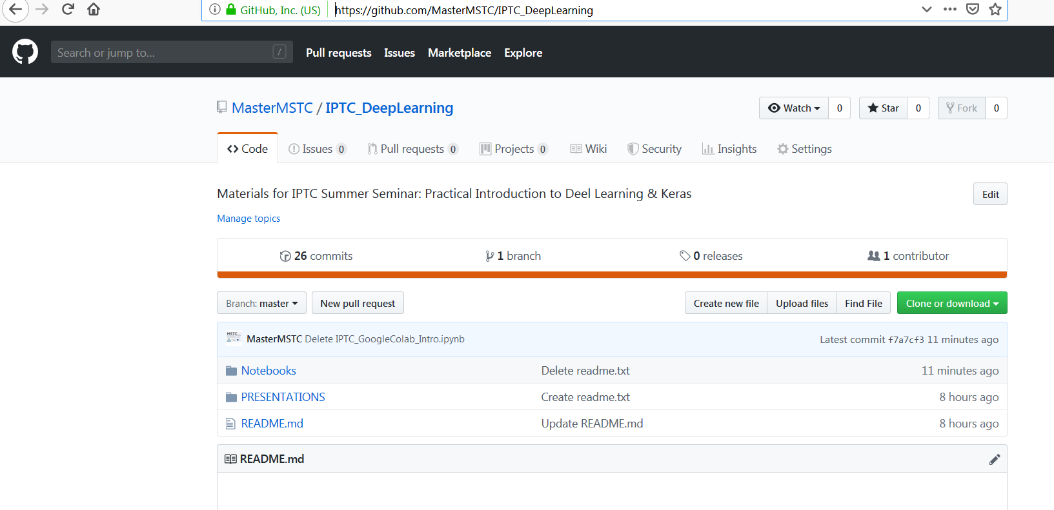
IPTC Summer Seminar MATERIALS
Please go to our MSTC GitHub:
https://github.com/MasterMSTC/IPTC_DeepLearning

Slide 3
Introduction to Deep Learning & Keras Day 1
Prof. Luis A. Hernández Gómez
luisalfonso.hernandez@upm.es

Slide 4
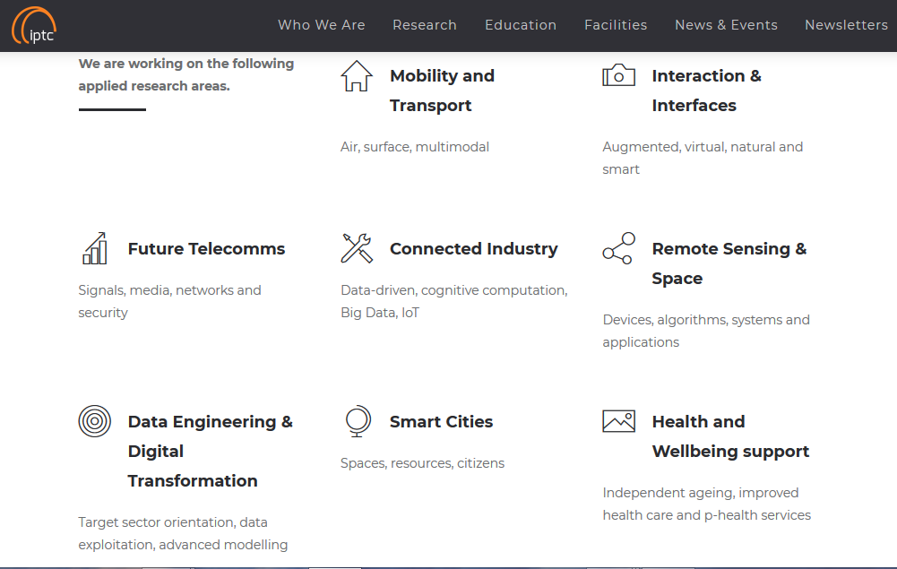



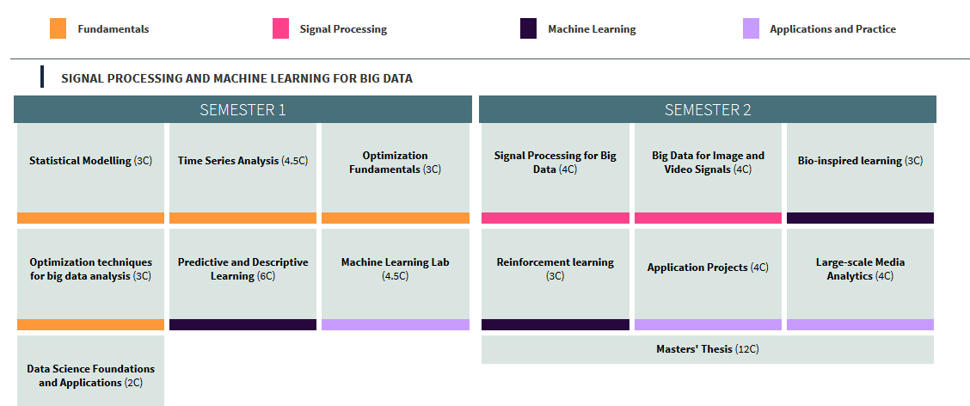
IPTC Information Processing and Telecommunications Center
https://iptc.upm.es/
Master Program
http://www.mstc.ssr.upm.es/big-data-track

Slide 5
Day 1 (July 15) : Intro to Deep Learning & Keras.
Feed Forward models
Day 2 (July 16) : Backpropagation. Convolutional Networks
Transfer Learning. Data Augmentation.
Day 3 (July 17) : Recurrent Networks. Advanced Architectures.
GANs. Applications. Final discussion on AI

Slide 6
The Artificial Intelligence Renaissance:
deep learning and the road to human-Level machine intelligence
https://www.cambridge.org/core/journals/apsipa-transactions-on-signal-and-information-processing/article/artificial-intelligence-renaissance-deep-learning-and-the-road-to-humanlevel-machine-intelligence/A82CA4909877C98B23755744A18EA64F

Slide 7
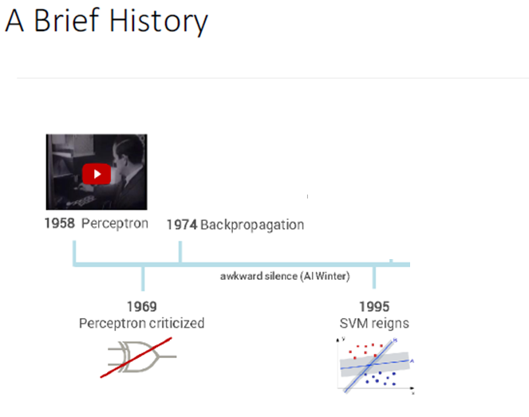
Deep Learning: Hype or Reality?
Deep Learning using TensorFlow and TensorFlow-Slim
Dipendra Jha Northwestern University

Slide 8
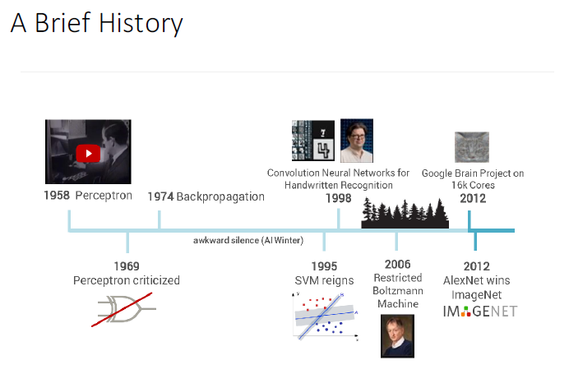
Deep Learning: Hype or Reality?
Yann LeCun'
Geoffrey Hinton:
Deep Learning using TensorFlow and TensorFlow-Slim
Dipendra Jha Northwestern University

Slide 9
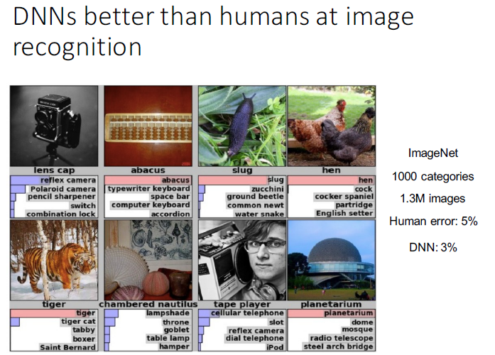
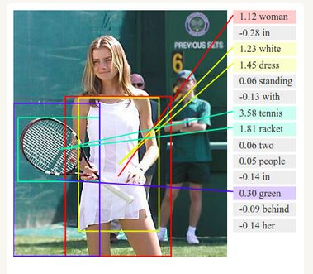
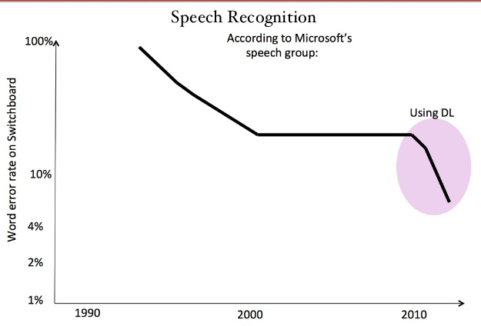
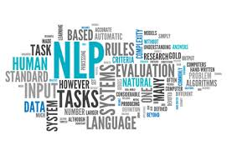
Deep Learning: Hype or Reality?
Super Human!

Slide 10
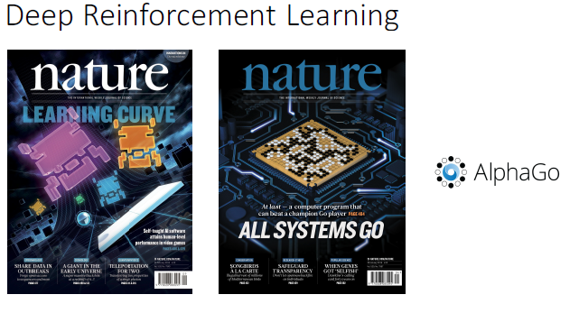
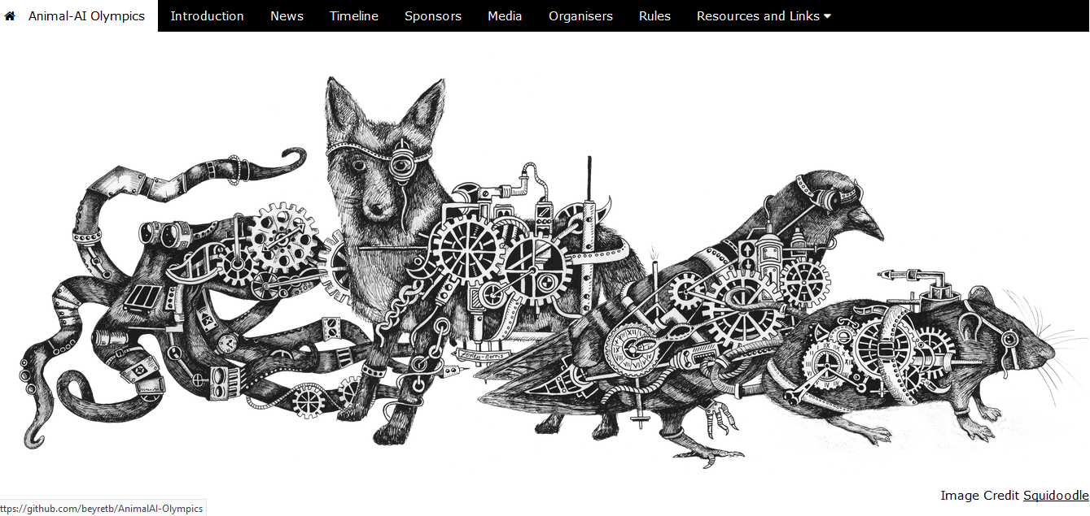
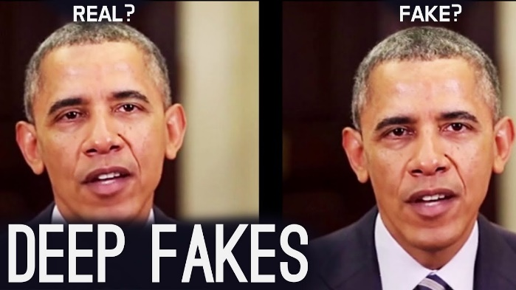
Humanoid Robots
Conversational AI : Social Bots
July 8th, 2019

Slide 11
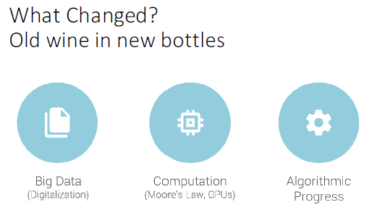
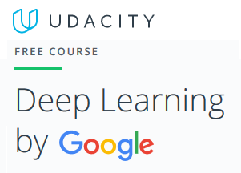
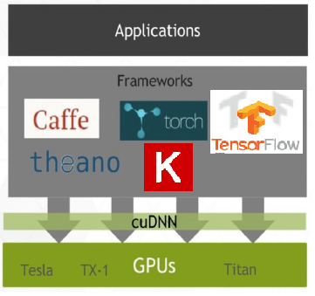
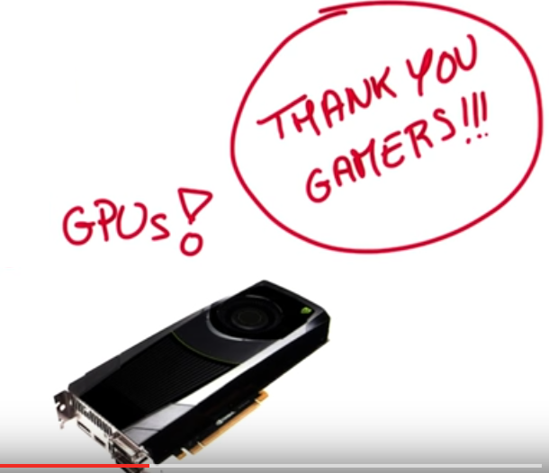
Introduction to Deep Learning but what is new?

Slide 12
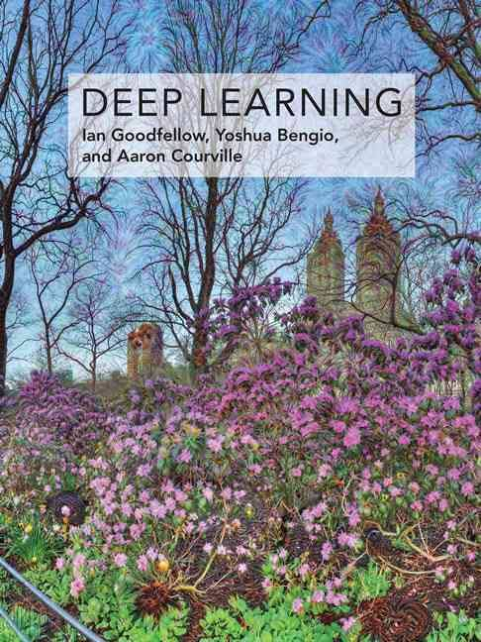
Introduction to Deep Learning …the Machine Learning background…
Learn the whole
Machine Learning context
On line:
www.deeplearningbook.org
Deep Learning courses
Prof. Hung-yi Lee National Taiwan University (NTU) Taipei

Slide 13
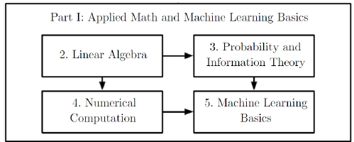
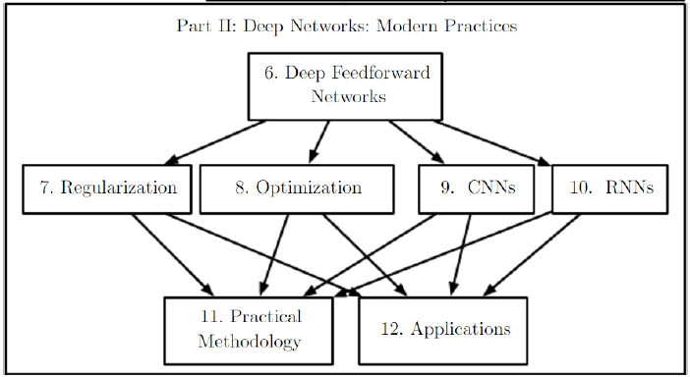
Introduction to Deep Learning …the Machine Learning background…

Slide 14
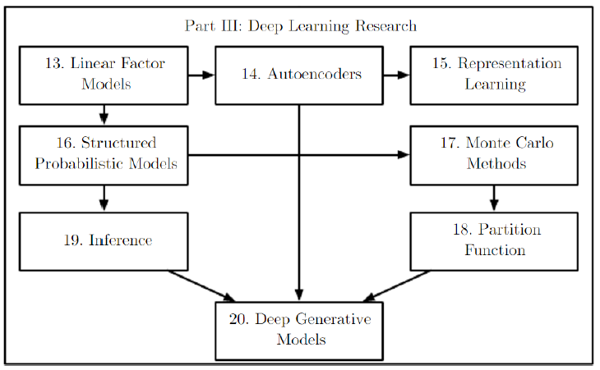
Introduction to Deep Learning …the Machine Learning background…

Slide 15
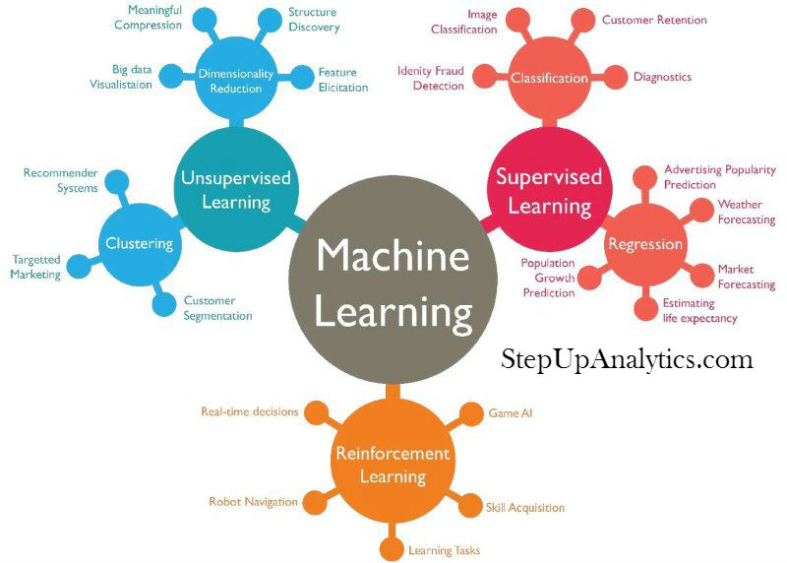

Slide 16
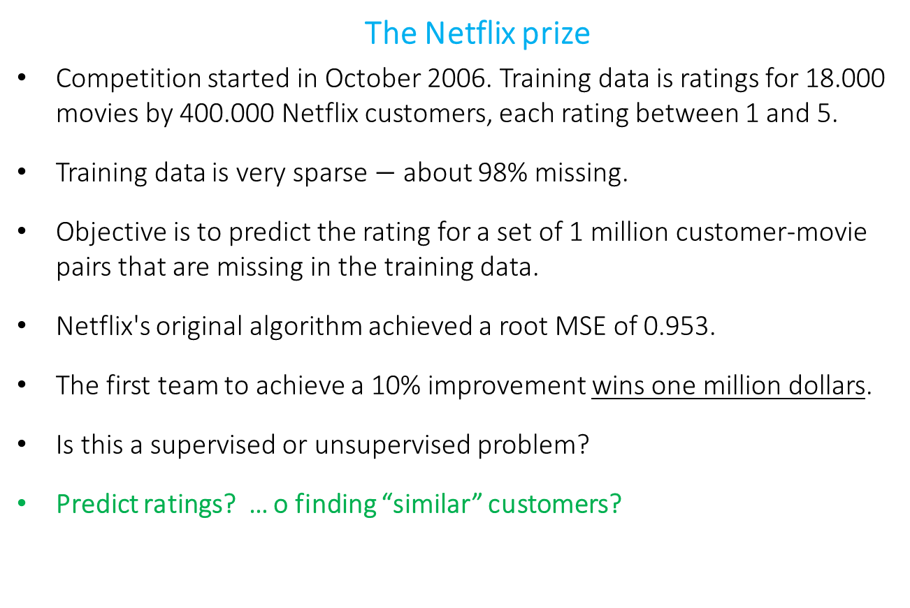
Supervised or unsupervised? Recommendation systems (I)
The Netflix prize
Competition started in October 2006. Training data is ratings for 18.000 movies by 400.000 Netflix customers, each rating between 1 and 5.
Training data is very sparse $−$ about 98% missing.
Objective is to predict the rating for a set of 1 million customer-movie pairs that are missing in the training data.
Netflix's original algorithm achieved a root MSE of 0.953.
The first team to achieve a 10% improvement wins one million dollars.
Is this a supervised or unsupervised problem?
Predict ratings? … o finding “similar” customers?

Slide 17
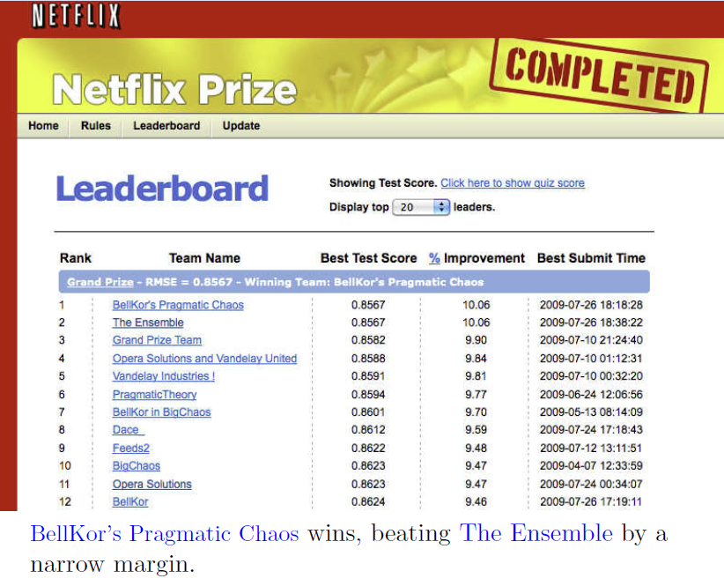
Supervised or unsupervised? Recommendation systems (II)

Slide 18
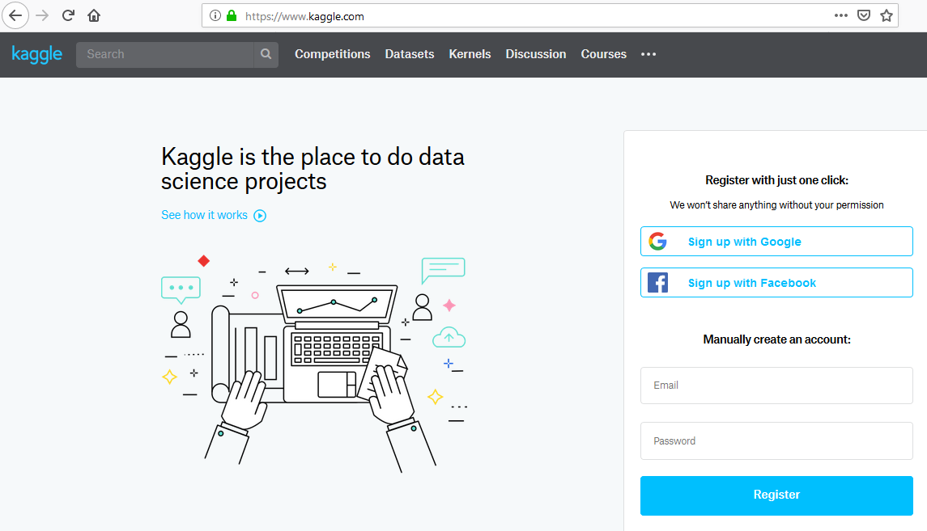

Slide 19
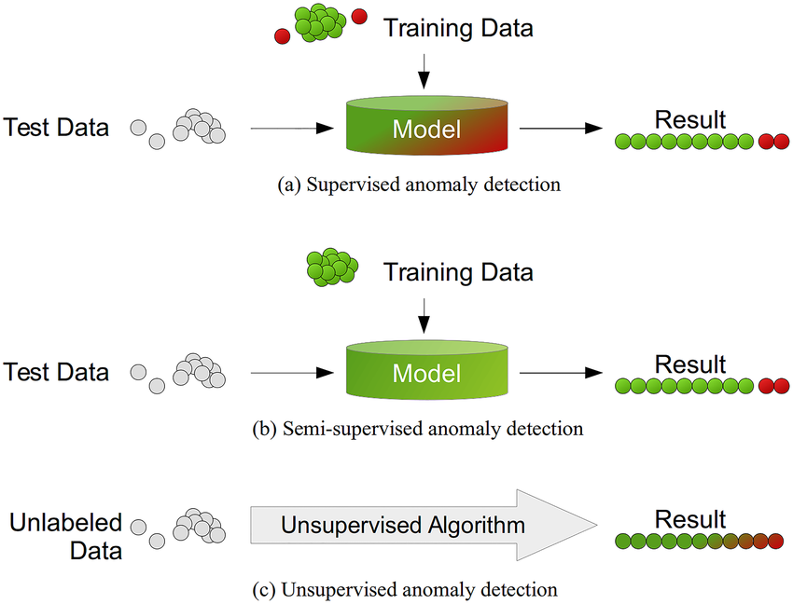
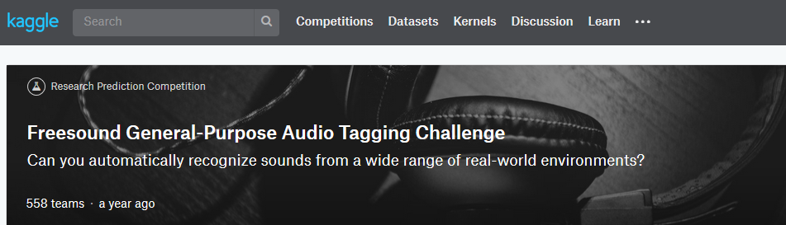
Supervised or unsupervised?
Fraud detection?
Anomaly detection?
Sound classification (FreeSound Challenge)
Noisy labels

Slide 20
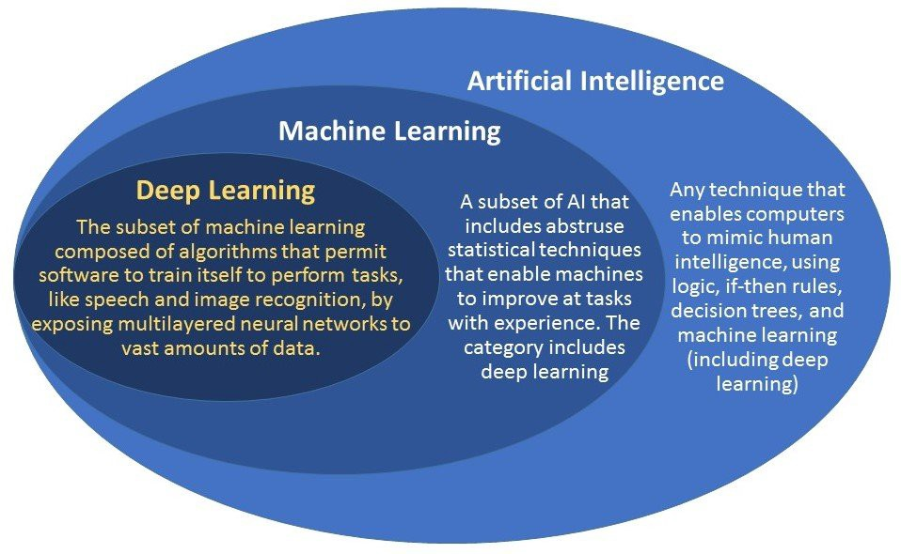

Slide 21
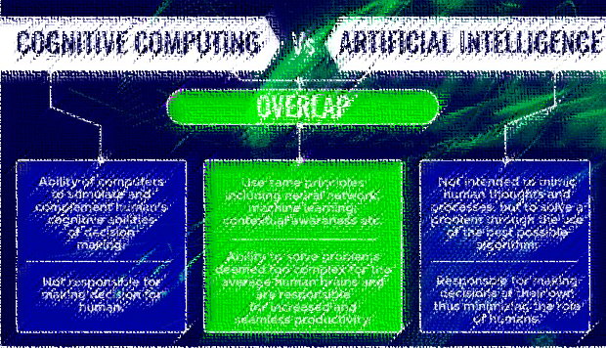
Research by your own on: …we will discuss it by the end of Seminar (day-3)
Cognitive Computing
Artificial General Intelligence (AGI)

Slide 22
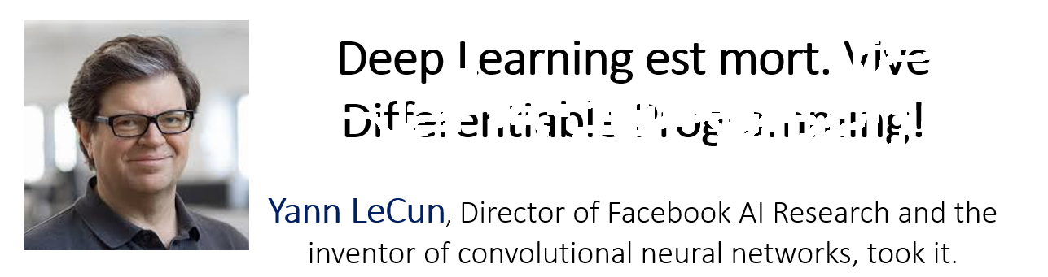

Slide 23
FROM : humans …
to machines …
and to Artificial Intelligence (AI)

Slide 24
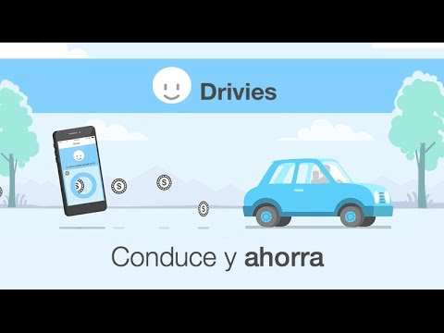
Drivies use case:
www.driviesapp.com

Slide 25
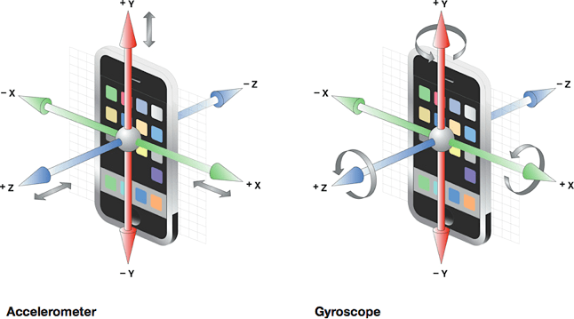

Slide 26
m/seg^2
time
Radians/sec
time

Slide 27
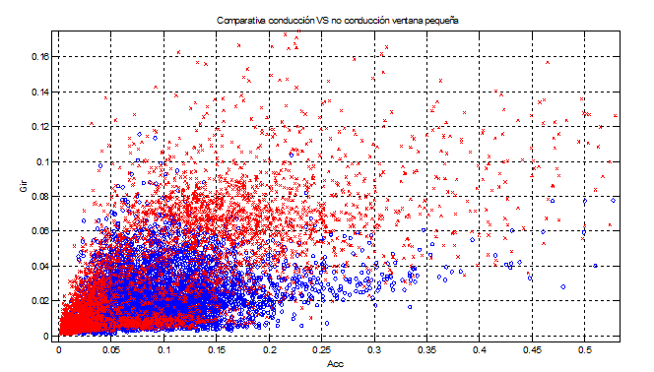
From manual - linear classifiers TO Neural Networks

Slide 28
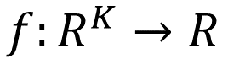
Driving detection (yes/no)
= define a decision function
No-driving=0
$$f:R^{K}→R$$
Driving=1

Slide 29
From linear classifiers TO Neural Networks
A Linear decision function
…
weights
bias

Slide 30
From linear classifiers TO Neural Networks
A Linear decision function

Slide 31
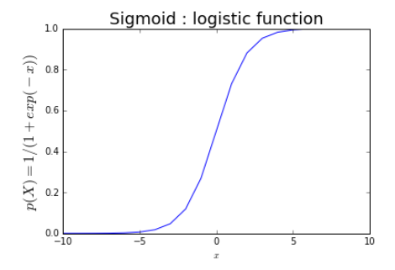
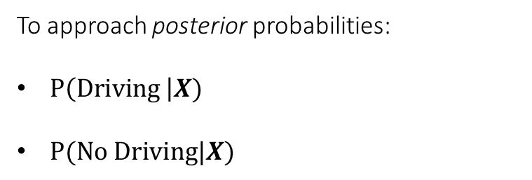
From linear classifiers TO Neural Networks
We typically use a Sigmod Function
To approach posterior probabilities:
$P\left(Driving \right|X)$
$P(No Driving|X)$
Logistic Regression

Slide 32
From linear classifiers TO Neural Networks
Nonlinear decision function?
No-driving=0
$$f:R^{K}→R$$
Driving=1

Slide 33
Non-linear decision functions
A linear model of transformed inputs:

Slide 34
How choosing the mapping ?
Feature engineering (based on expert knowledge)
Use a very generic as kernel machines (e.g. SVM, RBF kernel)
The strategy of deep learning : to learn

Slide 35

Hand-crafted
kernel function
From: DL Tutorial
Hung-yi Lee
SVM
Apply simple classifier
Source of image: http://www.gipsa-lab.grenoble-inp.fr/transfert/seminaire/455_Kadri2013Gipsa-lab.pdf

Slide 36
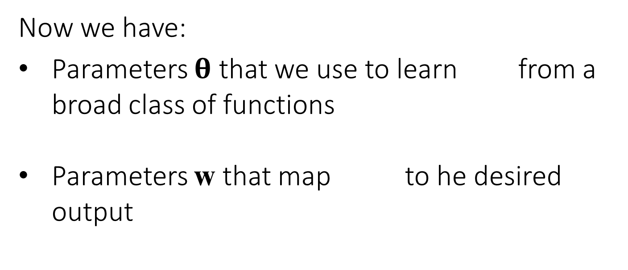
The DL approach: learn
Now we have:
Parameters $θ$ that we use to learn from a broad class of functions
Parameters w that map to he desired output

Slide 37
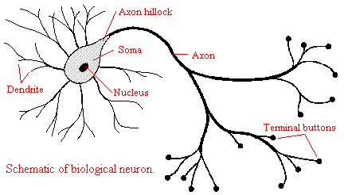
The DL approach: learn
…from a broad class of functions

Slide 38
Neuron approach….
…
Cumulative
influence
synaptic weights
Activation
Function
“all or none”

Slide 39
Neural Network (from Hung-yi Lee “Deep Learning Tutorial”)
neuron
Input
Layer 1
Layer 2
Layer L
Output
……
y₁
……
y₂
……
……
……
……
……
……
y_{M}
Input Layer
Output Layer
Hidden Layers
Deep means many hidden layers

Slide 40
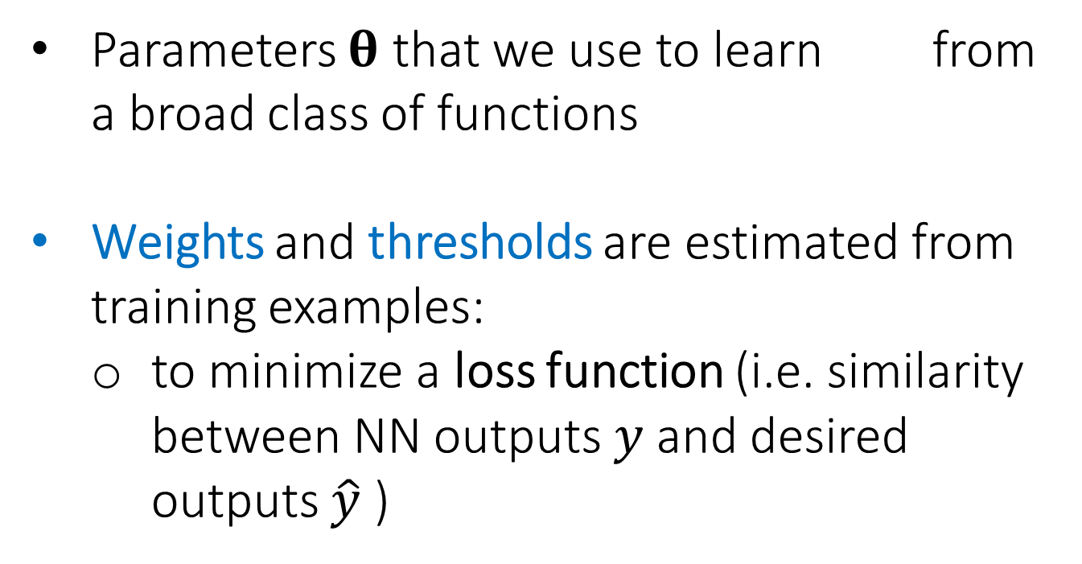
From linear classifiers TO Neural Networks
Parameters $θ$ that we use to learn from a broad class of functions
Weights and thresholds are estimated from training examples:
to minimize a loss function (i.e. similarity between NN outputs $y$ and desired outputs $\hat{y}$ )

Slide 41
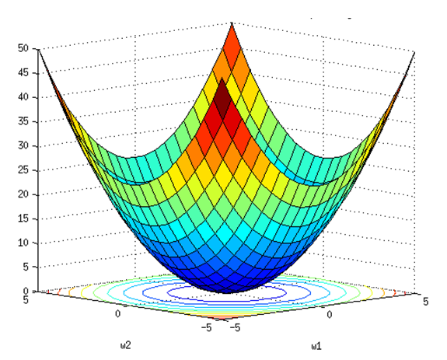
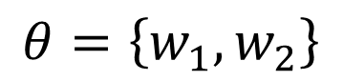
Gradient Descent
OPTIMIZATION
Cost
Or
Loss function
C(𝜃)
Assume there are only two parameters w₁ and w₂ in a network.
$$θ=\left\{w_{1},w_{2}\right\}$$

Slide 42
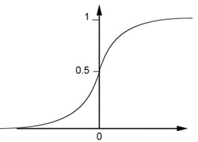
…
… gradients!
continuous activation!
…25 years… Paul J. Werbos (1974)
…as Sigmoid function
weights
Threshold
Sigmoid Function
bias

Slide 43
But recall that this is also logistic regression!
…
weights

Slide 44
Dense Layer, Multilayer Perceptron (MLP), Feedforward Deep Networks
……
……
……
Shallow
Deep

Slide 45


Slide 46
Feature Extraction + Final Linear Classifier
Input
Layer 1
Layer 2
Layer L
Output
……
y₁
……
y₂
……
……
……
……
……
……
y_{M}
Input Layer
Output Layer
Hidden Layers
Feature Extraction
Linear Classifier

Slide 47
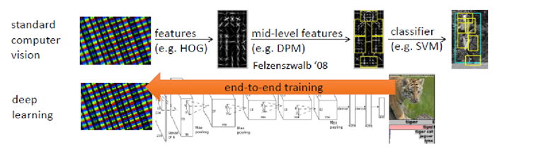
End-to-end
REVOLUTION!

Slide 48
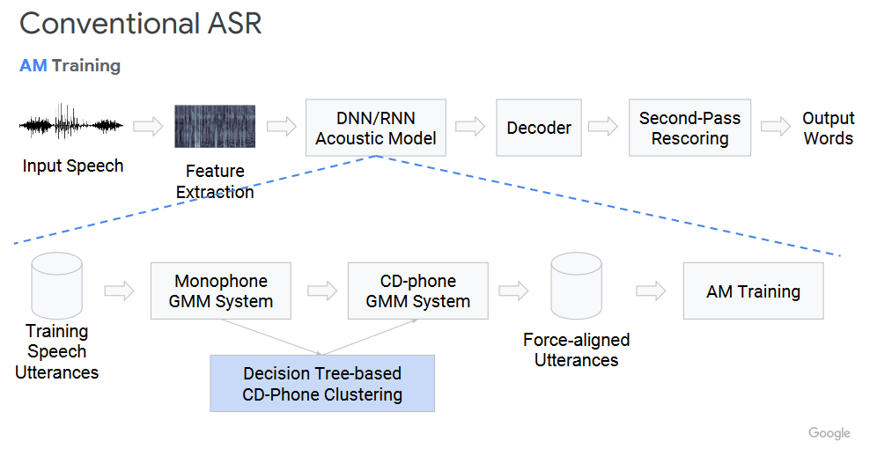

Slide 49
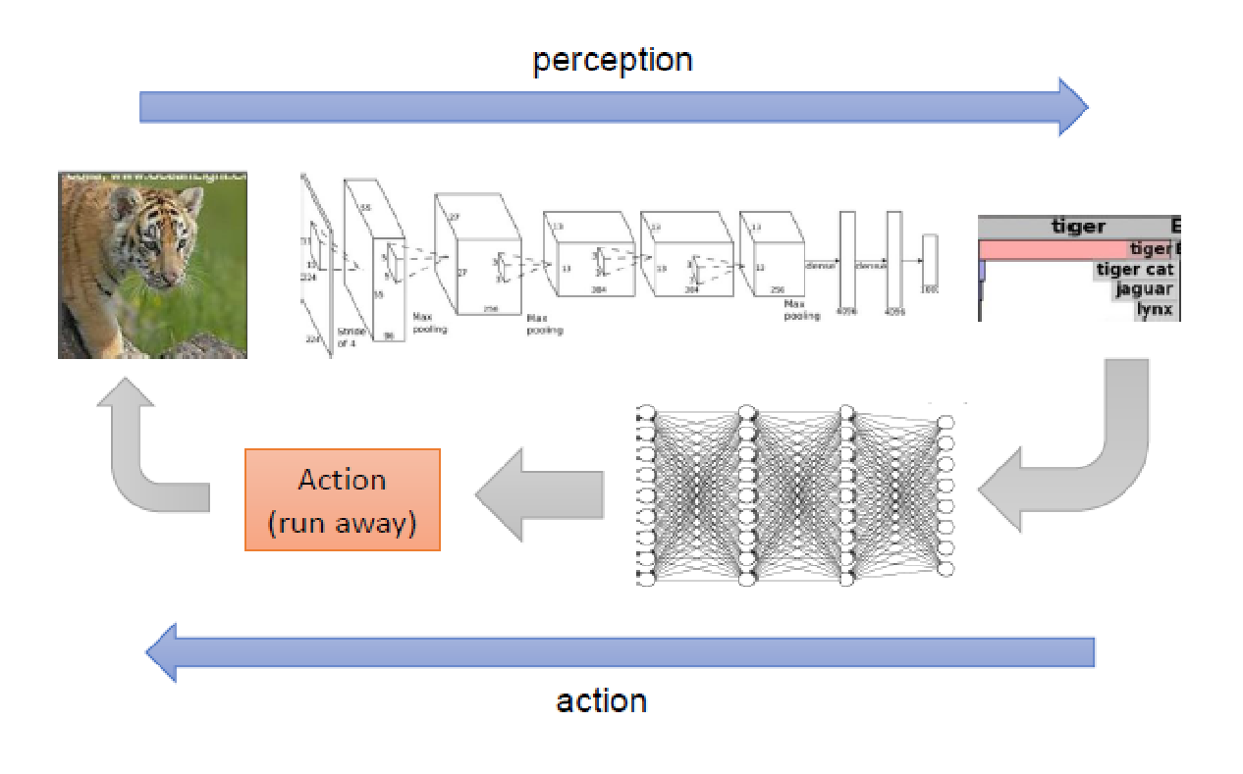
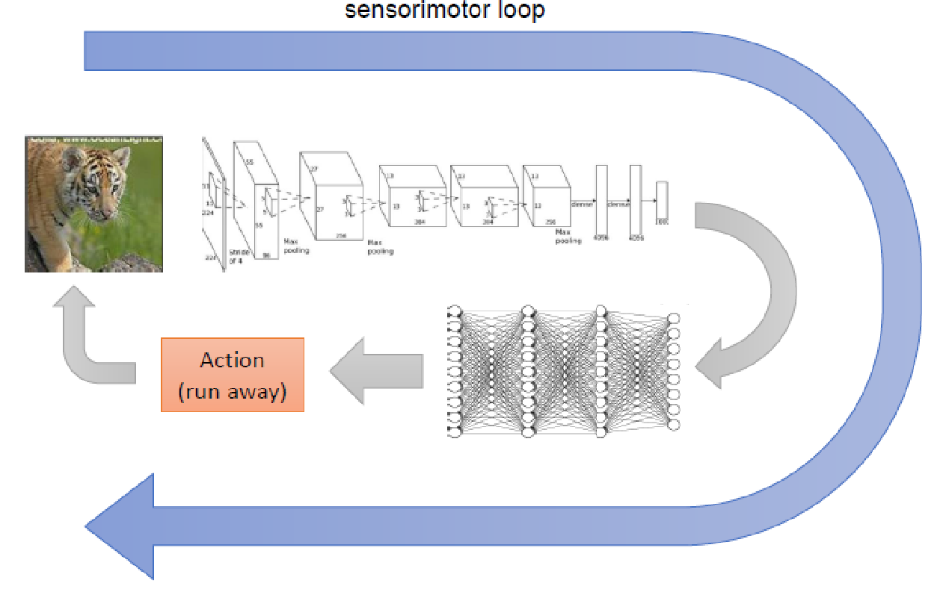
Deep
End-to-end
REVOLUTION!

Slide 50
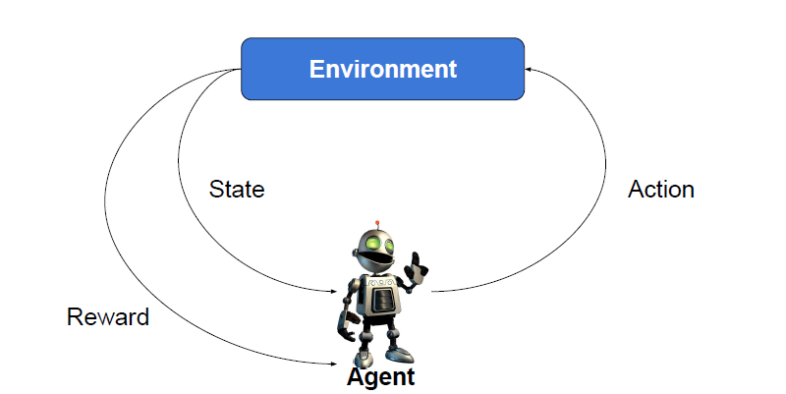
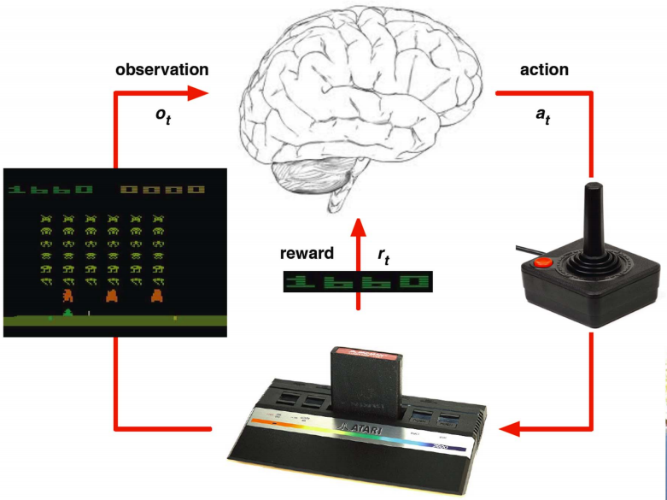
What’s Reinforcement Learning?
Agent interacts with an environment and learns by maximizing a reward.
No labels or any other supervision is given.

Slide 51
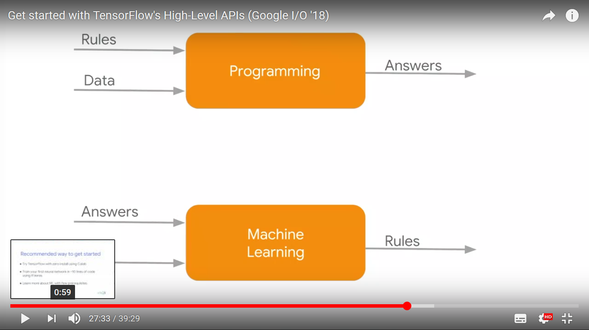

Slide 52
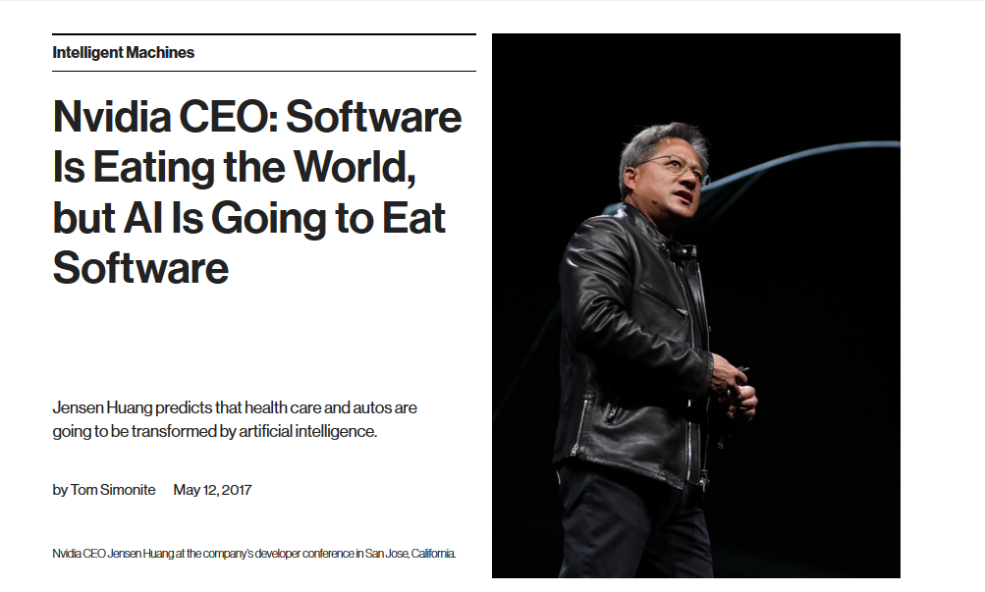

Slide 53

https://towardsdatascience.com/battle-of-the-deep-learning-frameworks-part-i-cff0e3841750

Slide 54

Google TensorFlow
Library for writing “machine intelligence” algorithms
Very popular for deep learning and neural networks
Can also be used for general purpose numerical computations
Interface in C++ and Python

Slide 55


Slide 56


Slide 57


Slide 58

Deep Learning: some on-line resources
Keras Tutorial: Deep Learning in Python
10 Best Machine Learning & Deep Learning Courses [2019 UPDATED]
https://digitaldefynd.com/best-machine-learning-and-deep-learning-courses/

Slide 59

Keras: The Python Deep Learning library
Guiding principles
User friendliness
Modularity
Easy extensibility
Work with Python

Slide 60
BUT WHERE to (play) run your programs (scripts)
Your local machine (ANACONDA)
On the cloud
Google Colaboratory
https://colab.research.google.com/notebooks/welcome.ipynb
Kaggle kernels (powered by Google)
https://www.kaggle.com/docs/kernels
IBM Cognitive Labs
https://labs.cognitiveclass.ai

Slide 61
Training and Testing:
MNIST
Deep Learning Hello World!

Slide 62

Go to:
https://www.tensorflow.org/tutorials

Slide 63

To Run it: You must login using your Gmail account

Slide 64


Access with my/your Gmail account
https://console.cloud.google.com/education

Slide 65


Slide 66

The Jupyter architecture: Jupyter is built from three parts:
The notebook front end. The front end allows you to edit and run notebooks (JavaScript application)
The Jupyter server, which is either a relatively simple application that runs on your laptop, or a multi-user server. The Jupyter project’s JupyterHub is the most widely used multi-user server for Jupyter.
The kernel protocol, which allows the server to offload the task of running code to a language-specific kernel. Jupyter ships with kernels for Python 2 and Python 3, but kernels for many other languages are available.

Slide 67


Slide 68


Slide 69

Now CREATE YOUR OWN Python 3 Notebook

Slide 70


Slide 71

Save it….
WHERE?

Slide 72

By default it is saved into your Google Drive under folder “Colab Notebooks”

Slide 73


Slide 74

Please go to our MSTC GitHub:
https://github.com/MasterMSTC/IPTC_DeepLearning
…and copy from Notebooks:
IPTC_GoogleColab_Intro.ipynb
…into your: Google Drive

Slide 75

Now, from your Google Drive open the Notebook
IPTC_GoogleColab_Intro.ipynb
…using Google Colab

Slide 76


Let’s try to develop an Image Classifier using
a FeedForward Network
Output
Probabilities
Hidden layer 1
128
Hidden layer 2
32
Output layer
5
y₁
Font 1
0.1
0.4
Font 2
Softmax
…
…
……………
……
y₁₀
0.2
Font 5
Notes:
The same for even more complex tasks.

Slide 77


Font type Recognition
Notes:
The same for even more complex tasks.

Slide 78
Softmax Layer
The output of a Classifier is a categorical variable
In REGRESSION the output y is a Numerical variable
BUT in CLASSIFICATION y is a Categorical one
So: How to represent Categorical variables?
y = {cats, dogs, birds, ants}
Why not just to assign “1”, “2” , “3” ?
…and what for a LARGE number of categories
(as words!) …. sparsity (a lot of zeros)….
OHE : One-Hot encoding
cats : 1 0 0 0
dogs: 0 1 0 0
birds: 0 0 1 0
ants: 0 0 0 1
On Day-3 we will talk about:
embeddings
Great in NLP
(Natural Language Processing)
Notes:
The same for even more complex tasks.

Slide 79

One-hot-encoding (OHE)
Number of
Categories
(N=5)
Categories
Type 1
1 0 0 0 0
0 1 0 0 0
0 0 1 0 0
0 0 0 1 0
0 0 0 0 1
Type 2
Type 3
Type 4
Type 5

Slide 80
Output
Probabilities
Hidden layer 1
128
Hidden layer 2
32
Output layer
5
y₁
Font 1
0.1
0.4
Font 2
Softmax
…
…
……………
……
y₁₀
0.2
Font 5
Notes:
The same for even more complex tasks.

Slide 81

Softmax layer as the output layer
Probability:
$1>y_{i}>0$
$\sum_{i}{y_{i}=1}$
Softmax Layer
3
20
0.88
1
2.7
0.12
-3
0.05
≈0

Slide 82
Font type Recognition
IPTC_Keras_FontReco_FeedFordward.ipynb
Available at:
https://github.com/MasterMSTC/IPTC_DeepLearning
Notes:
The same for even more complex tasks.

Slide 83

Reshape (we need a 1D input)
Input
reshape
36 x 36 = 1296
Elements [0:255]
White pixel → 0
Black pixel → 255
PLEASE BE AWARE OF HOW CRITICAL IS TO NORMALIZE INPUTS TO Neural Networks

Slide 84
Input
Image
Vector
Output
Probabilities
Hidden layer 1
128
Hidden layer 2
32
Output layer
5
y₁
Font
Type 1
0.1
0.4
Font
Type 1
Softmax
…
…
……………
……
y₁₀
Font
Type 5
0.2
Notes:
The same for even more complex tasks.

Slide 85


Feed Forward

Slide 86
What’s next for Day-2

Slide 87





Deep Learning Architectures
Notes:
Not memtion
DT v.s. Deep!!!!!

Slide 88

… and towards Day-3 : Deep learning basics
https://github.com/lexfridman/mit-deep-learning/blob/master/tutorial_deep_learning_basics/deep_learning_basics.ipynb

Slide 89
Some on-line courses
Practical:
UDACITY: Deep Learing by Google (DNN + TF)
Deep Learning with TensorFlow : Packt Video (our examples today from this!)
TensorFlow and Deep Learning without a PhD, Part 1 (Google Cloud Next '17)
https://www.youtube.com/watch?v=u4alGiomYP4
Theory:
Coursera Neural Networks for Machine Learning, as taught by Geoffrey Hinton (University of Toronto)
Andrew Ng : Deep Learning and Unsupervised Feature Learning

